Slide 1
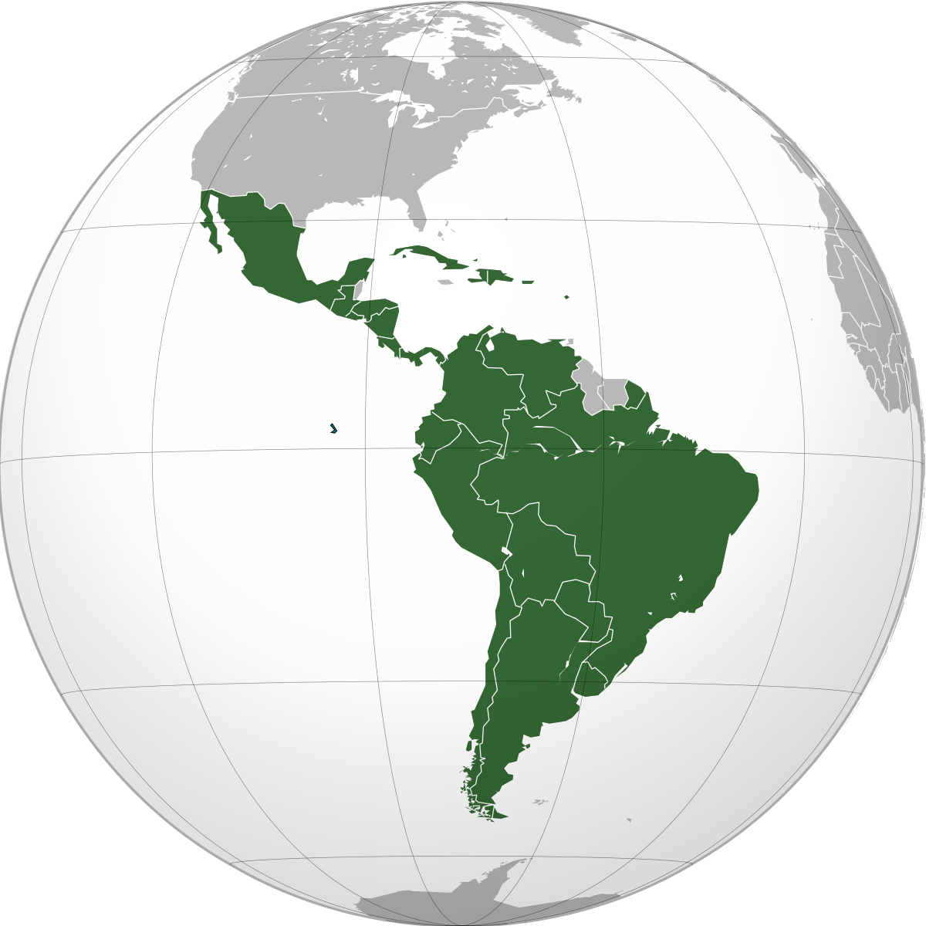
Latin America

Slide 2
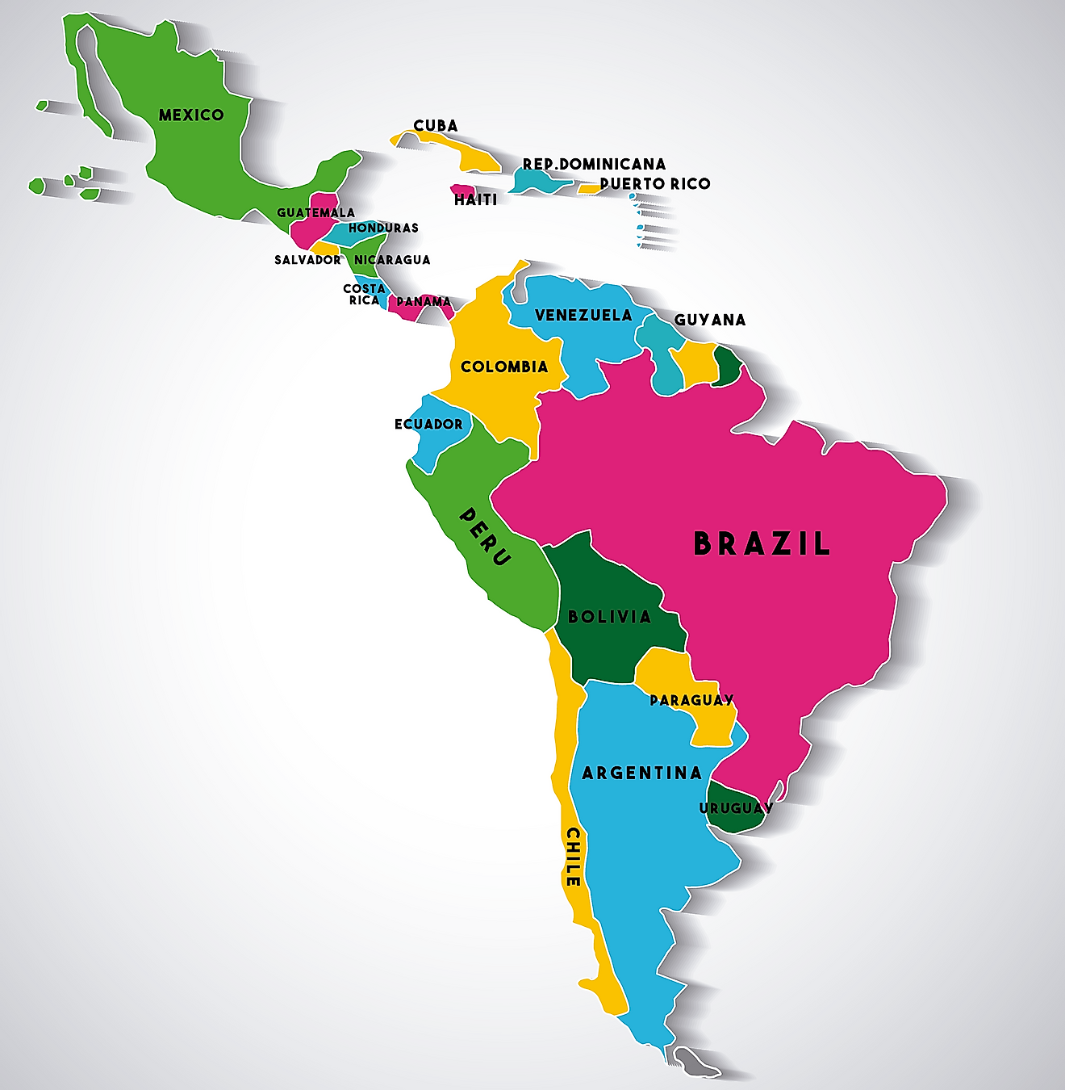
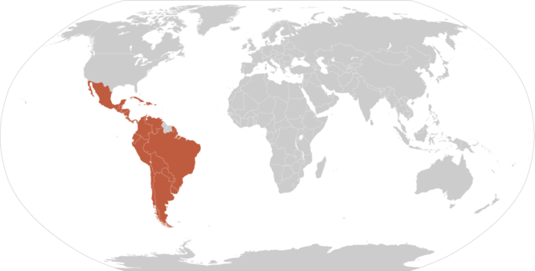

Slide 3
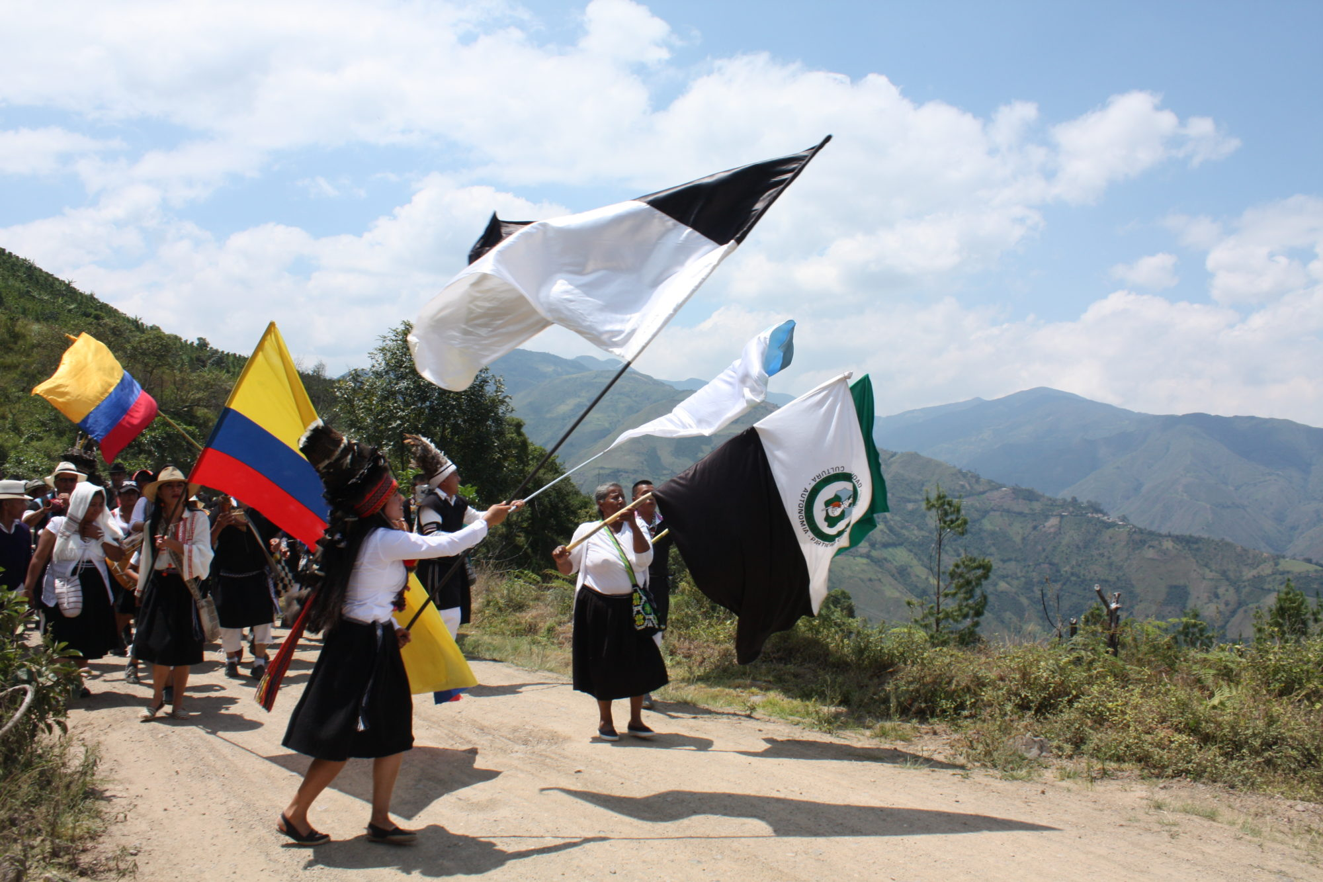
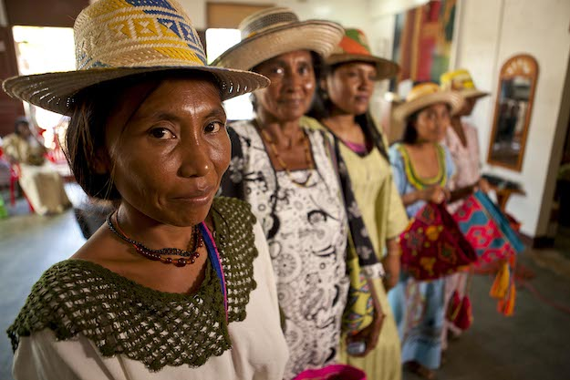
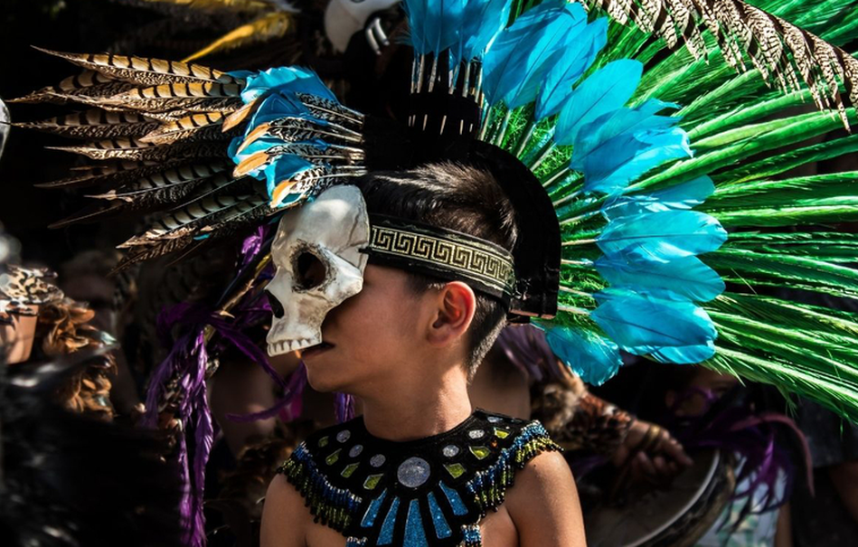

Slide 4
January 5 -13
Geographic Understandings
SS6G1 Locate selected features of Latin America.
Locate on a world and regional political-physical map: Amazon River, Amazon Rainforest, Caribbean Sea, Gulf of Mexico, Atlantic Ocean, Pacific Ocean, Panama Canal, Andes Mountains, Sierra Madre Mountains, and Atacama Desert.
b. Locate on a world and regional political-physical map the countries of Brazil, Chile, Colombia, Cuba, Mexico, and Panama.
SS6G2 Explain the impact of environmental issues in Latin America.
Explain the causes and effects of air pollution in Mexico City, Mexico.
b. Explain the environmental issue of destruction of the rain forest in Brazil.

Slide 5
Thursday, January 5
Standard: Geographic Understanding
SS6G1
Learning Target: I can identify political and physical features of Latin America.
Warm-up: Short Video ( Introduce Latin America)
Work Session: Cloze Notes (Brain Wrinkles); Latin America Map; SS WB pages 129-133; Environmental issues of Latin America.
Students will begin working on Social Studies Project (MLK/ Latin American Leaders)
Closing: TOD
Reminders:

Slide 6
Students will begin working on their Social Studies Project.
This project will have two parts (Martin Luther King and Latin America Leaders).

Slide 7
Friday, January 6
Standard: Geographic Understanding
SS6G1
Learning Target: I can identify political and physical features of Latin America.
Warm-up: Short Video ( Introduce Latin America)
Work Session: Cloze Notes (Brain Wrinkles); Latin America Map; SS WB pages 129-133; Environmental Issues in Latin America (air pollution and destruction of rain forest)
Students will begin working on Social Studies Project (MLK/ Latin American Leaders)
Closing: TOD
Reminders:

Slide 8
